Slide 1


OCTOBER 1st AND BEYOND:
H-1B CHANGE OF STATUS, THE NEW RULES AND YOUR 2027 IMMIGRATION BUDGET
Wednesday September 23, 2026

Slide 3




INTRODUCTION
Meltzer Hellrung combines an innovative service model, proprietary technology, and a creative immigration team
200+ corporate clients: Global 200, Fortune 500, Venture-backed unicorns
Recognized in 2023 by Crain Magazine as a top 100 best places to work in Chicago
Meltzer Hellrung has been ranked in the Illinois Chambers Spotlight 2027 Guide and recognized as a top law firm handling high-quality work.
Meltzer Hellrung has been named a 2025 Inc. Power Partner
Meltzer Hellrung received a Tier 1 recognition in Immigration Law in the 2026 edition of Best Law Firms®

Slide 4
INTRODUCTION
Responsive
Client-focused
Responsive
Average Email Response Time: 4.5 hours
91+ NPS Scores
Efficient
Program Management
Transfer case turnaround: 10 business days
Account team, regular touchpoints

Slide 6

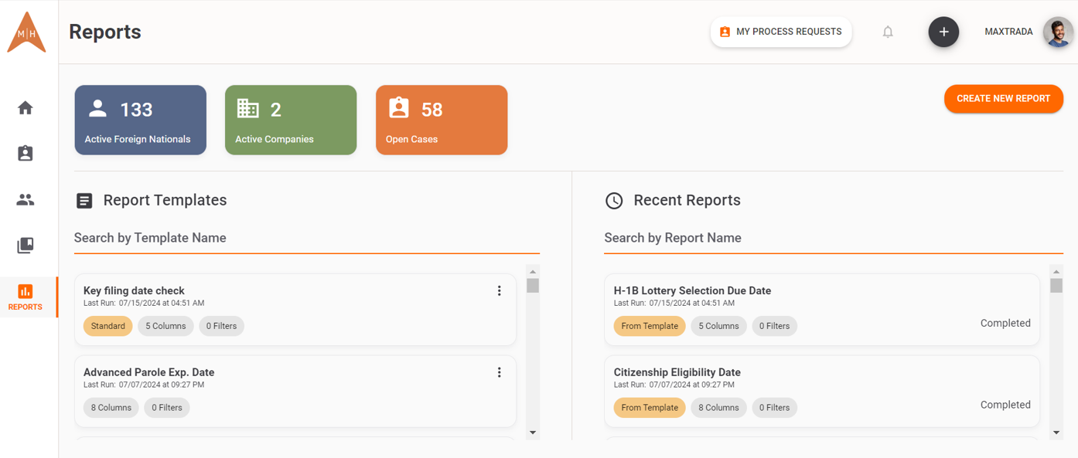
VOYAGER®
Our proprietary immigration program management platform
Drives process efficiency, transparency, and centralization of all immigration information
Core Features:
Dashboards that drive transparency
Efficient workflow automations that save time
Extensive immigration reporting capabilities
Comprehensive knowledge center

Slide 7


PRESENTERS
MATTHEW MELTZER
Co-Founder and Managing Partner
Specializes in assisting foreign companies to enter the U.S. market and building custom solutions for entrepreneurial and high net-worth clients. Most recently recognized as one of Crain's Chicago Business Notable Leaders in Accounting, Consulting & Law!

Slide 8

PRESENTERS
MATTHEW HELLRUNG
Co-Founder and Managing Partner
Specializes in scaling immigration programs for high-growth clients via immigration policy creation and stakeholder training. Matthew has represented clients from a variety of industries, including information technology, engineering, education, manufacturing, and entertainment industries.

Slide 9
AGENDA

Slide 10
AGENDA
Part 1: What you have to get right this month
  Reverifying I-9s for employees changing status on October 1
  FICA starts: ending the F-1 student exemption and getting the payroll effective date right
  Cap-gap, pending petitions, and what to do if the COS isn't approved by 10/1
Part 2: The rule pipeline, and what's actually law
  FINAL Fixed periods of admission replace duration of status for F, J, and I — why you now have to monitor I-94s
  FINAL Downstream effects on CPT programs and program extensions
  PROPOSED The $103,265 cap-subject fee — including change-of-status filings, with no master's exemption as drafted
  IN LITIGATION The $100,000 proclamation fee: vacated, on appeal, and the refund question
  PROPOSED Ending the 60-day grace period for E, H-1B, L-1, TN, and O-1 workers — and what a termination day looks like without it
  PROPOSED DOL prevailing wage increases across H-1B, E-3, and PERM and PERM changes
Part 3: Building a 2027 budget you can defend
  Weighted selection in the March 2027 cap registration: how it changes who you register
  Modeling headcount cost under each proposed rule

Slide 11
H-1B CAP UPDATES

Slide 12
H-1B CAP UPDATES
H-1B approvals automatically take effect October 1st
For individuals with approvals re-verify I-9 on October 1st
Individuals with FICA exemptions stop as of 9/30
FICA exemptions for company and employee for first 5 years in F-1 or J-1 status
Year is the year of entry, not measured as 5 years from date of entry
Cap Gap through April 1st for pending petitions for individuals with expiring OPT

Slide 13
H-1B REMINDERS

Slide 14
H-1B REMINDERS
Employees switching to H-1B will need a new visa stamp to travel and re-enter the US after international travel.
If you terminate an H-1B employee, notify counsel so the H-1B can be withdrawn.
Company is obligated to offer to cover the cost of return travel to the employee’s home country.
If an employee changes worksite, let counsel know in advance. Depending on the change an amendment may be needed. Public access file compliance may also be required.
Speak to counsel before any changes to job title or negative changes in compensation. Compensation raises do not require action. Speak to counsel before moving an H-1B employee from part-time to full-time or vice versa.

Slide 15
F-1 AND J-1, THE POTENTIAL END OF DURATION OF STATUS

Slide 16
F-1 AND J-1, THE POTENTIAL END OF DURATION OF STATUS
Trump administration published a final rule ending duration of status for individuals in F-1 and J-1 statuses.
A federal judge in Massachusetts paused the implementation of the rule as of September 15th.
What the rule would do:
  End D/S and move all individuals to an exact expiration date.
  F-1 students who were admitted in D/S before September 15, 2026, and are properly maintaining F-1 status on September 15, 2026, are authorized to remain in the United States in F-1 status until the later date of either the expiration date on their EAD, or the program end date on their Form I-20. They are also eligible for a grace period of up to 60 days. Their period of stay may not exceed November 14, 2030 (4 years after the effective date of the rule, plus a 60-day grace period).
  F-1 students who travel internationally after the Final Rule takes effect will no longer be covered by the transition rules. They will be issued a Form I-94 with an AUD and become subject to the New Rule.
Employers should track all F-1 and J-1 employees with counsel.
Employees should notify employers of travel and track I-94’s upon re-entry.

Slide 17
F-1 AND J-1, THE POTENTIAL END OF DURATION OF STATUS
Employers should track all F-1 and J-1 employees with counsel.
Employees should notify employers of travel and track I-94’s upon re-entry.

Slide 18
CHANGES TO CPT

Slide 19
CHANGES TO CPT
Curricular practical training is used by students while in school. No EAD is required.
OPT is available to students in school, but is often impractical, except for summer internships, because it requires up to 4 months of advance planning for work.
Without any notice, ICE (which administers CBP programs at schools) made enormous changes to CPT.
  CPT now only authorized if school program requires all students in the program (regardless of immigration status) to work, without an opt out path.
Most CPT programs functionally nullified
This will make internships and externships much harder to provide to foreign students
Day 1 CPT programs may also be much harder to come by.

Slide 20
STATE OF THE 2025 $100,000 FEE RULE

Slide 21
CHANGES TO CPT
The underlying executive order is still in place and was recently renewed for another year.
The First Circuit has upheld an injunction pausing the implementation of the rule.
USCIS may not be abiding by the terms of the injunction. We have multiple cases that should be exempt that are paused in processing for absence of submission of the $100,000 fee.
This rule only applies to consular processing cases

Slide 22
$103,265 H-1B FEE OF 2026

Slide 23
CHANGES TO CPT
Proposed regulation under consideration to subject all H-1B cap cases. There is no exemption for individuals seeking a change of status inside the US.
The proposed fee is supposed to cover costs well beyond the H-1B program. It is the nature of this purpose that makes the proposed regulation legally suspect. There is no authority for USCIS to collect fees to support other agencies.
Timeline:
  Expected final regulation in December to February
  Litigation to ensue immediately after
  H-1B lottery registration period mid March, 2027
  H-1B submission period closes June 30, 2027
Give clarity to employees about how the company will proceed with regards to the lottery registration.

Slide 24
EXECUTIVE ORDER DIRECTING
INTER-AGENCY COORDINATION FOR H-1B REVIEW

Slide 25
EXECUTIVE ORDER DIRECTING INTER-AGENCY COORDINATION FOR H-1B REVIEW
USCIS, Department of Labor, Department of Commerce, Department of Education, and SBA, asked to coordinate to look at impact of layoffs when considering H-1B applications.
H-1B dependent employers and those companies with large layoffs where positions are outsourced to other companies should be most aware of this EO.
This includes companies that had layoffs previously, not just recently.

Slide 26
ENDING THE 60-DAY GRACE PERIOD FOR E, H-1B, L-1, TN, AND O-1 WORKERS

Slide 27
ENDING THE 60-DAY GRACE PERIOD FOR E, H-1B, L-1, TN, AND O-1 WORKERS
60 day grace period has been in place since 2017. Prior to then there was no grace period.
Proposed regulation to end the grace period entirely, not just scale it back.
Employers need to cover cost of return transportation for H-1B and O-1 employees
Dependent spouses lose work authorization immediately as well. Consider H-1B cap sponsorship for employees in dependent statuses.

Slide 28
ENDING THE 60-DAY GRACE PERIOD FOR E, H-1B, L-1, TN, AND O-1 WORKERS
Terminations and RIFs considerations
  Garden leave versus severance pay
  Advance preparation of B visa change of status requests
  Counseling for employees
Recruitment considerations
  Laid off workers may not be able to remain in US, or even if so, may not be able to start based on change of status due to long pending B-1 cases
  Expect more foreign travel to start work
  Fundamental consideration of existing visa stamp

Slide 29
POTENTIAL PERM CHANGES

Slide 30
POTENTIAL PERM CHANGES
Expected regulation to modernize PERM recruitment practices to ensure companies are recruiting consistent with regular advertising and recruitment practices
Companies should consider starting PERMs in the next six months, if they would not do so already, to ensure they are recruiting under the existing regulatory framework.
PERMs may be harder to get approved and more costly for recruitment under the new framework.

Slide 31
BUILDING A 2027 BUDGET

Slide 32
BUILDING A 2027 BUDGET
Legal fees, filing fees, expenses such as education evaluations and advertising expenses
Do you have an immigration policy?
  Do you cover the costs of dependent visas?
  Do you know when green card processes get initiated?
  When do you cover premium processing?
  What parts of the green card process does the company pay for?
If you don’t have a policy, we can help you write one

Slide 33
WHAT TO CONSIDER FOR YOUR BUDGET

Slide 34
WHAT TO CONSIDER FOR YOUR BUDGET
Budget maximally, rather than conservatively. It is way easier to save money than seek additional funds.
Known extensions
Green card initiations
I-140’s based on certified PERMs
Adjustment of status cases
New hires
Intracompany transfers
Global and business travel
RFE costs

Slide 35
WHAT TO CONSIDER FOR YOUR BUDGET
H-1B cap cases
  Will your company pay any fees?
  Will your company initiate cases based on certain legal benchmarks?
Buffer costs for hourly guidance

Slide 37






QUESTIONS?
MATTHEW HELLRUNG
Co-Founder and Managing Partner
mhellrung@meltzerhellrung.com
MATTHEW MELTZER
Co-Founder and Managing Partner
mmeltzer@meltzerhellrung.com
Follow us on:

