Slide 1


USCIS JUST CHANGED THE H-1B RULES. IS YOUR NEXT FILING READY?
May 27, 2026

Slide 3
INTRODUCTION

Slide 8
PRESENTERS

Slide 9


PRESENTERS
MATTHEW MELTZER
Co-Founder and Managing Partner
Specializes in assisting foreign companies to enter the U.S. market and building custom solutions for entrepreneurial and high net-worth clients. Most recently recognized as one of Crain's Chicago Business Notable Leaders in Accounting, Consulting & Law!

Slide 10

PRESENTERS
MICHAEL TURANSICK
Senior Counsel
With 30+ years of immigration law experience. He has advised Fortune 100 companies and startups on strategy, compliance, and policy. A former Managing Partner and AILA policy counsel, Michael brings deep expertise and practical insight

Slide 12

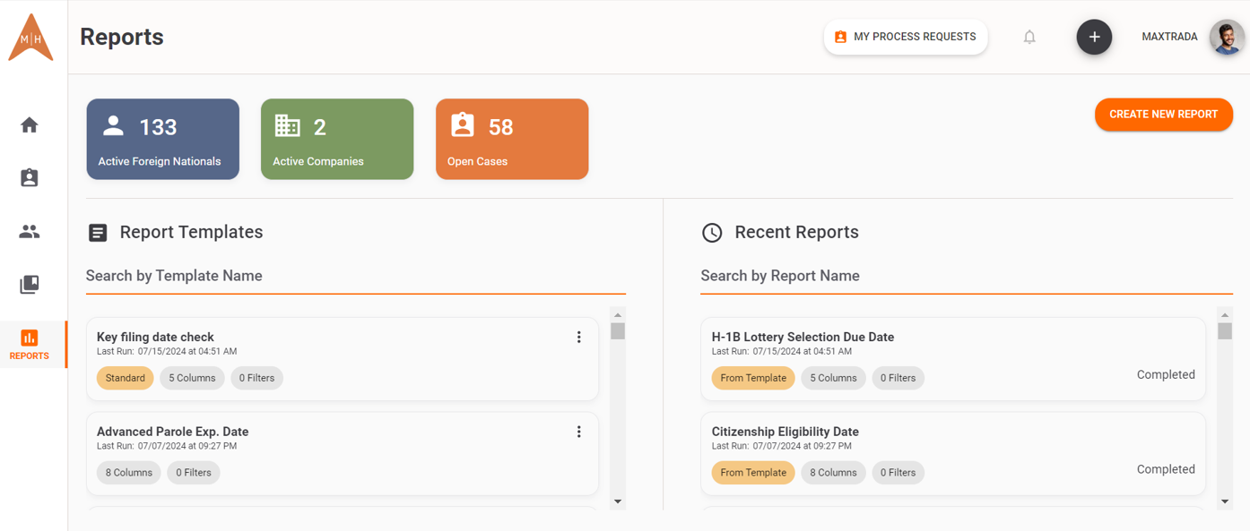
VOYAGER®
Our proprietary immigration program management platform
Drives process efficiency, transparency, and centralization of all immigration information
Core Features:
Dashboards that drive transparency
Efficient workflow automations that save time
Extensive immigration reporting capabilities
Comprehensive knowledge center

Slide 13
AGENDA

Slide 14
AGENDA
Aligning the LCA + Form I-129
USCIS RFE Based on the New Questions
FY 2027 Lottery Selection Data
New USCIS Policy Memorandum on Adjustment of Status
New Data Required for H-1B Petitions:
Form I-129 – H-1B Data Collection Supplement
Building an Audit-Ready Process
Proposed regulatory changes - Impact on LCA Wages

Slide 15
FY 2027 LOTTERY SELECTION DATA

Slide 16
FY 2027 LOTTERY SELECTION DATA
Total Registrations: 211,600 (down from 343,981 in FY 2026)
Advanced Degrees: 71.5% of selected individuals hold a U.S. master’s degree or higher (up from 57% the previous year)
Selection Rates by Wage Level:
  Level I: ~31%
  Level II: ~58%
  Level III: ~70%
  Level IV: ~74%
Will USCIS conduct another selection round?

Slide 17
NEW USCIS POLICY MEMORANDUM ON
ADJUSTMENT OF STATUS

Slide 18
NEW USCIS POLICY MEMORANDUM ON
ADJUSTMENT OF STATUS
What’s New
USCIS has reaffirmed that adjustment of status is discretionary relief -not an automatic right- even when all eligibility requirements are met.
Officers are now expressly instructed to look more carefully at:
  Any prior immigration violations or overstays
  Whether consular processing abroad was a viable option
  Conduct inconsistent with prior visa or parole status
Having no negative factors alone is no longer sufficient — applicants must also show meaningful positive equities.

Slide 19
NEW USCIS POLICY MEMORANDUM ON
ADJUSTMENT OF STATUS
What Hasn’t Changed
Approval is still available for well-prepared applicants. Officers must still weigh all factors - positive and negative - in the totality of the circumstances.
Strong positive factors still carry significant weight:
  Deep family ties in the United States
  Long-term lawful residence and community ties
  Good moral character and employment history
  Hardship if required to apply from abroad
Dual-intent visa holders (H-1B, L-1, O-1) are expressly recognized by the memo as a valid pathway

Slide 20
NEW DATA REQUIRED FOR H-1B PETITIONS

Slide 21
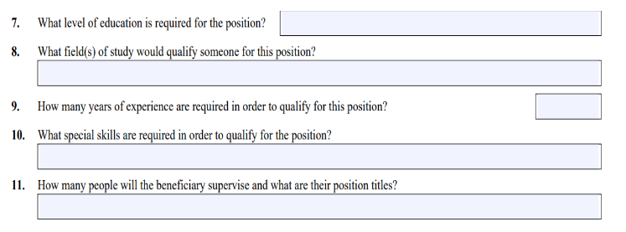
NEW DATA REQUIRED FOR H-1B PETITIONS
Form I-129 – H-1B Data Collection Supplement

Slide 22
NEW DATA REQUIRED FOR H-1B PETITIONS
Why were these questions added?
Combat alleged abuse of the H-1B program – Unsubstantiated allegations that U.S. employers seek to hire foreign workers at lower wages than American workers.
Mirror the DOL's prevailing wage level factors. These are the same factors the Department of Labor uses to assign a prevailing wage level.
Enable USCIS to verify consistency of the H-1B registration, H-1B petition and PERM application.

Slide 23
NEW DATA REQUIRED FOR H-1B PETITIONS
What information did MH previously provide?
Statute requires that bachelor's degree or higher, in an area directly related to the job, is normally required for the position.
No requirement to list experience, skills or supervision.
How are we responding now?
Refer adjudicator to attached petition for relevant education, experience, skills and supervisory responsibilities appropriate for the job.
  Complies with statute and regulations
  Routine approvals to date

Slide 24
ALIGNING THE LCA + FORM I-129

Slide 25
ALIGNING THE LCA + FORM I-129
How are prevailing wage determinations (PWD) calculated?
Occupational Classification: The appropriate SOC occupational code determined by the employer's job duties, drives the wage determination.
"Area of Intended Employment“ - physical location of the job directly determines the specific prevailing wages applicable to the job.
PWDs begin at the entry-level (Level I) wage.
  Analysis then works upward through a structured, five-step process, awarding points for experience, education, special skills, and supervisory duties that exceed what is generally required for the occupation
  The sum of points determining the final wage level (I through IV)

Slide 26
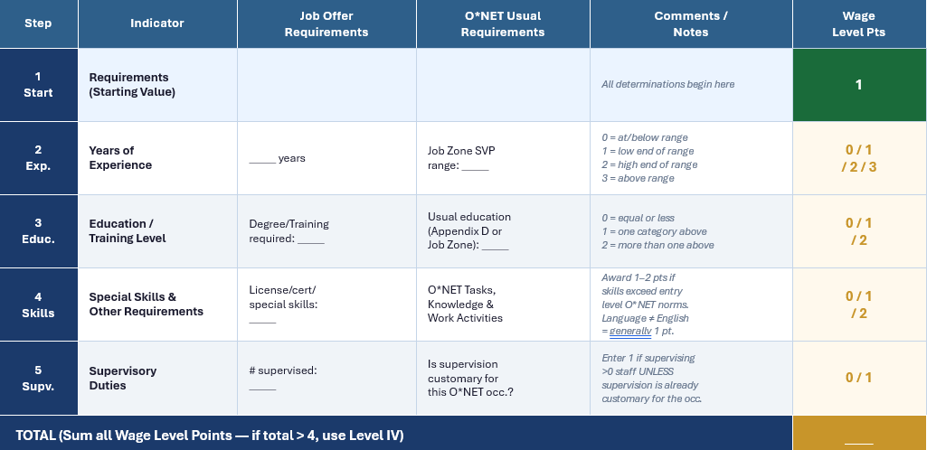
OES WAGE LEVEL CALCULATION WORKSHEET

Slide 27
RECENT DEVELOPMENTS - USCIS RFES BASED ON
THE NEW QUESTIONS

Slide 28
RECENT DEVELOPMENTS - USCIS RFES BASED ON
THE NEW QUESTIONS
January 2025 USCIS regulation confirmed its authority to review LCAs to verify they properly correspond with the H-1B petition.
New Data Supplement questions enable USCIS to access more wage level data.
Reports indicate recent RFEs have included detailed analysis of Education, Experience, Special Skills and Supervisory responsibilities.
  USCIS conducts separate wage level analysis and issues RFE if it alleges employer wage level is too low.
Recommendation: develop and maintain detailed documentation of wage leveling process at time of LCA preparation in anticipation of USCIS review.

Slide 29
BUILDING AN AUDIT-READY PROCESS

Slide 30
BUILDING AN AUDIT-READY PROCESS
What is USCIS looking for and how does that impact compliance?
Consistency across an individual’s petitions
  Initial and Extensions when no change in job duties
Consistency across petitions for the same company
Consistency between USCIS petitions and organic recruitment processes
Consistency with PERM application

Slide 31
DOL PROPOSES SIGNIFICANT CHANGES TO PREVAILING WAGE LEVELS

Slide 32
DOL PROPOSES SIGNIFICANT CHANGES TO PREVAILING WAGE LEVELS
DOL has proposed a regulation that would dramatically increase prevailing wage levels for employment-based immigration programs including PERM, H-1B, H-1B1, and E-3.
The stated goal is to ensure wages reflect the experience, education, and supervision required — but the practical effect is a significant increase in the cost of sponsoring foreign workers.
Proposed wage level changes
Wage Level | Current Percentile | Proposed Percentile | Percentile Increase
Level I | 17th | 34th | +17
Level II | 34th | 52nd | +18
Level III | 50th | 70th | +20
Level IV | 67th | 88th | +22

Slide 34






QUESTIONS?
MATTHEW HELLRUNG
Co-Founder and Managing Partner
mhellrung@meltzerhellrung.com
MATTHEW MELTZER
Co-Founder and Managing Partner
mmeltzer@meltzerhellrung.com
MICHAEL TURANSICK
Senior Counsel
mturansick@meltzerhellrung,com
Follow us on:

